Slide 1
Memory Unit
Dr. Kazi Masudul Alam
Associate Professor Computer Science and Engineering Discipline Khulna University

Slide 2
Reading Materials
Elements of Computer Science, S.K. Sarkar and A.K. Gupta

Slide 3
What is Memory?
Computer memory is any physical device capable of storing information temporarily, like RAM (random access memory), or permanently, like ROM (read-only memory). Memory devices utilize integrated circuits and are used by operating systems, software, and hardware.

Slide 4
Need for Memory
To store the program and data during execution.
To store the program for repetitive use.
To store the data for future/periodical use.
To store the results for execution.

Slide 5
Memory Unit
Main Memory (Primary Memory)
Directly accessed by the CPU instruction set.
Used for program and data storage during computer operation.
Secondary Memory (Auxiliary or Backup)
Larger in size but slower than main memory
Used to store system programs and large data files
Internal Processor Memory
Small set of high speed registers
Temporary storage of instructions and data

Slide 6
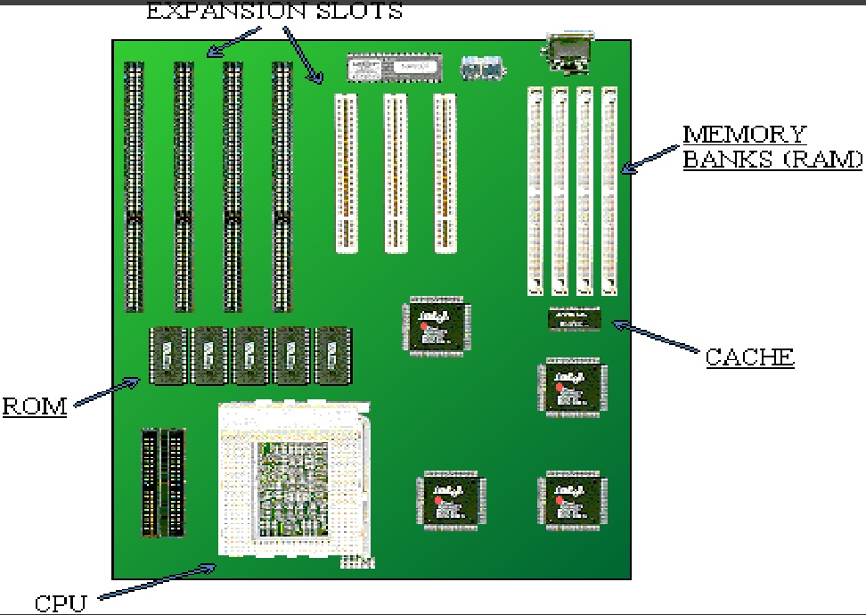

Slide 7
Memory Access Methods
Each memory type, is a collection of numerous memory locations. To access data from any memory, first it must be located and then the data is read from the memory location. Following are the methods to access information from memory locations:
Random Access: Main memories are random access memories, in which each memory location has a unique address. Using this unique address any memory location can be reached in the same amount of time in any order.
Sequential Access: This methods allows memory access in a sequence or in order.
Direct Access: In this mode, information is stored in tracks, with each track having a separate read/write head.

Slide 8
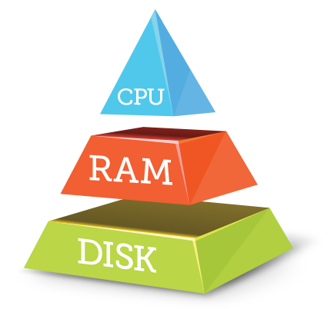
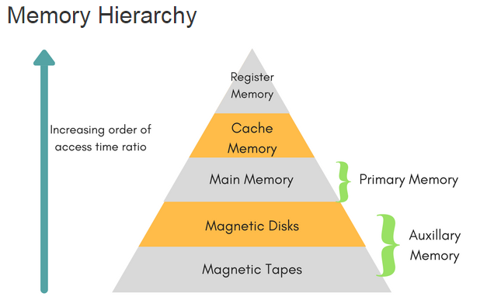

Slide 9
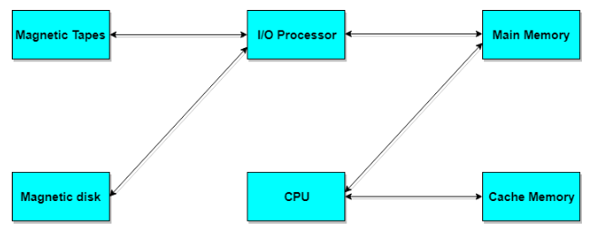

Slide 10
Memory Model
Consists of various storage locations
Stores certain number of bits. Each bit is either 0 or 1
Collection of 4 bits is called a NIBBLE
Collection of 8 bits called a BYTE
To store “A” we need 1 byte
Number of bits/bytes are grouped together to form a WORD
Length of WORD varies from computer to computer
8 bit WORD means a specific computer adder can add/subtract two 8 bit numbers at any time.
Size of memory measured in terms of total number of storage locations.
Expressed in Kilobytes (KB)
1 KB represents1024=2¹⁰ bytes
1 MB represents 1024 = 2²⁰ bytes = 2¹⁰ KB

Slide 11
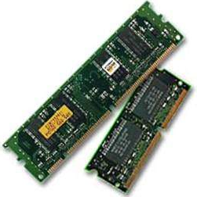
Main Memory: Random Access Memory (RAM)
Volatile Memory
Information is destroyed when power goes off.
A Non-volatile memory
Retains contents event after power failure.
Destructive Memory
Once the data is read from the memory its contents get lost.
In order to save the contents, data have to be rewritten after every read
Non-destructive Memory
Contents are retained even after the reading operation
Static RAM (SRAM)
Use flip-flop to store data – no need of refresh
Faster and more expensive than Dynamic RAM
More complex and low capacity
Dynamic RAM (DRAM)
Commonly used as primary memory
Use capacitor to store data. 1 – charged, 0 – discharged
Capacitor loose the charge. Hence need to refresh after some time

Slide 12
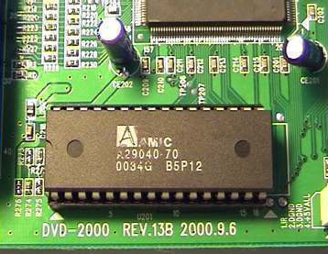
Main Memory:Read Only Memory (ROM)
Programmable ROM (PROM)
Programmed after manufacture.
Once they are programmed, cannot be changed (One Time Programmable) .
Erasable Programmable ROM (EPROM)
Can be erased by exposing to Ultraviolet (UV) radiation for a few minutes
Can be reprogrammed
Electrically Erasable and Programmable ROM (EEPROM)
Erase electrically not by UV
Can be erased block-wise
No need to take out the IC to erase

Slide 13
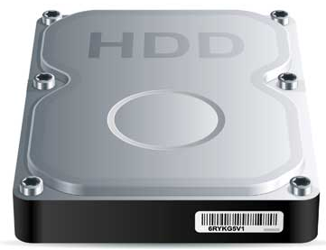
Secondary Memory
This type of memory is also known as external memory or non-volatile. It is slower than main memory. These are used for storing data/Information permanently. CPU directly does not access these memories instead they are accessed via input-output routines.
Characteristics
These are magnetic and optical memories
It is known as backup memory.
It is non-volatile memory.
Data is permanently stored even if power is switched off.
It is used for storage of data in a computer.
Computer may run without secondary memory.
Slower than primary memories.

Slide 14
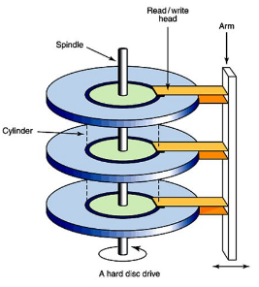
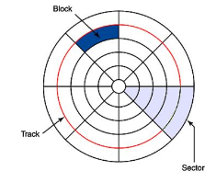
Secondary Memory : Magnetic Hard Disk
A read/write head travels across a spinning magnetic disk, retrieving or recording data.
Each disk surface is divided in tracks and tracks are divided into sectors.
Example of disk addressing scheme: surface 3, sector 5, track 4

Slide 15
Secondary Memory : Optical Disk
CD-ROM (Compact Disk-Read Only Memory)
Written once only during manufacture
Once written can not be erased
A low power laser beam is focused on the surface to read
WORM (Write Once Read Many)
Once written can not be destroyed without destroying the disk
Ideal for backup and archiving
Video scanners, keyboards, optical character recognition equipment can be recorded using WORM disks.
Erasable Optical Disk
Uses both laser and magnetic head to read and write the data
Data stored on the disk can be erased and rewritten
Data stored using lasers to heat magnetized areas coated with various metals.
Data erased using even more powerful laser at the disk

Slide 16
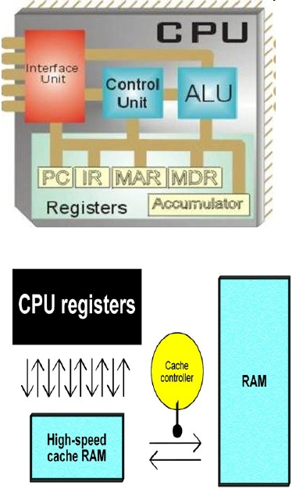
Processor Memory: CPU Registers
Registers are a group of circuits used for memory addressing, data operation and processing. Some of the registers are general purpose and some are reserved for certain functions.
Accumulator register is a special data register that stores initial data, intermediate and final results of the ALU operations.
Program counter (PC): Contains the addresses and status of an instruction. This CPU register always contains the memory address where the next instruction to be performed. Its content is copied into the MAR before an instruction is fetched from the main memory.
Instruction Register (IR): A special register that temporarily stores the instruction that has been fetched from the memory. It is subsequently decoded and interpreted for the actions to be performed.

Slide 17
CPU Registers
Memory Buffer Register (MBR): This register serves as an interface between the CPU and main memory, anything needed by the CPU (instruction or data) is first placed here before it goes to its final destination.
Memory Address Register (MAR): Used when another instruction is needed in the IR, or a value is to be loaded into the Accumulator

Slide 18
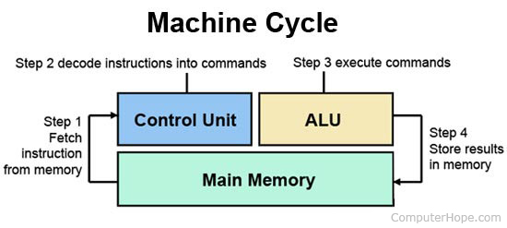

Slide 19
Say Sorry
Say Thank You
☺

